Slide 1


Acceleration of Saddle-Point Searches Assisted by Machine Learning
M. El Khatib; A. Khorshidi; A.A. Peterson Catalyst Design Laboratory, School of Engineering, Brown University.
Providence, RI, United States.
Providence, 31st August 2017.

Slide 2
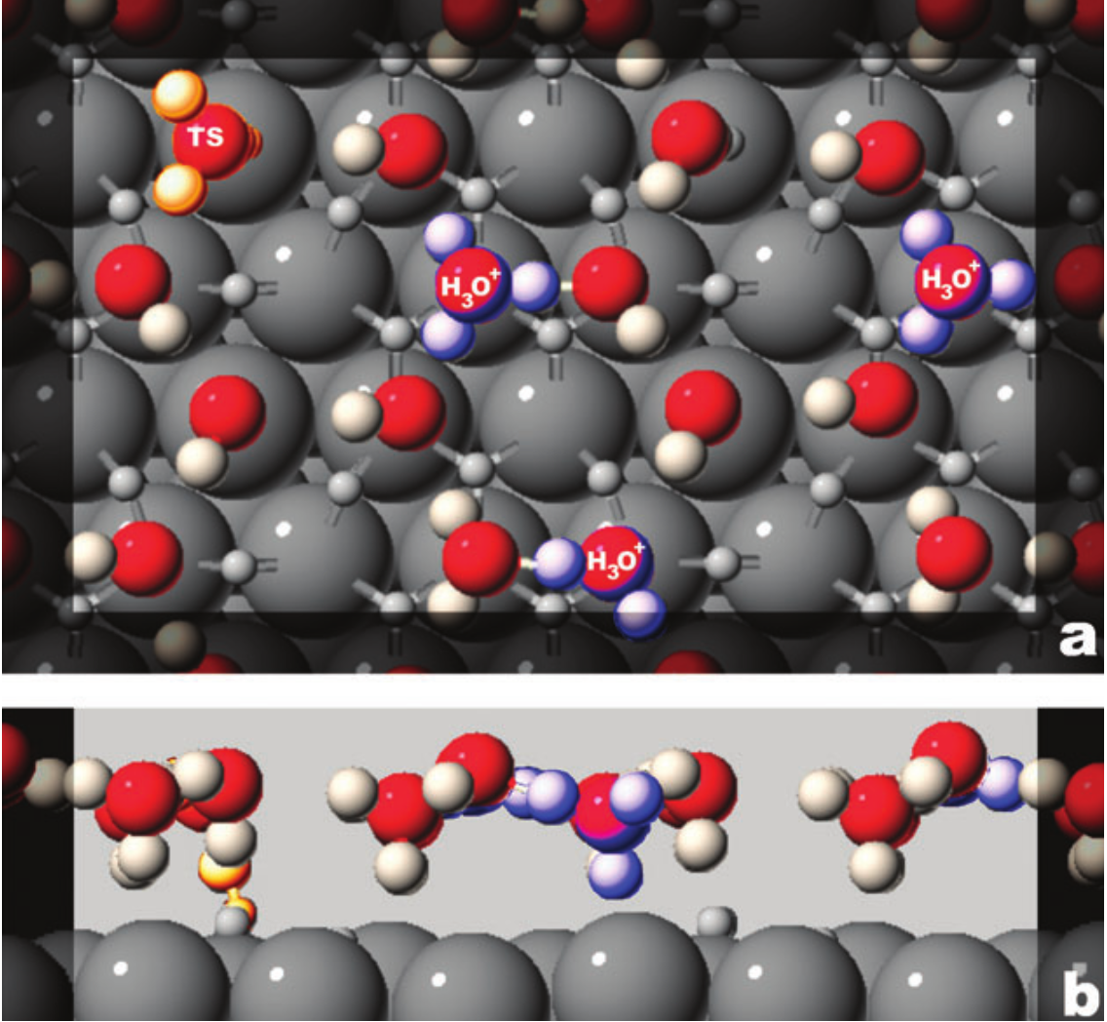
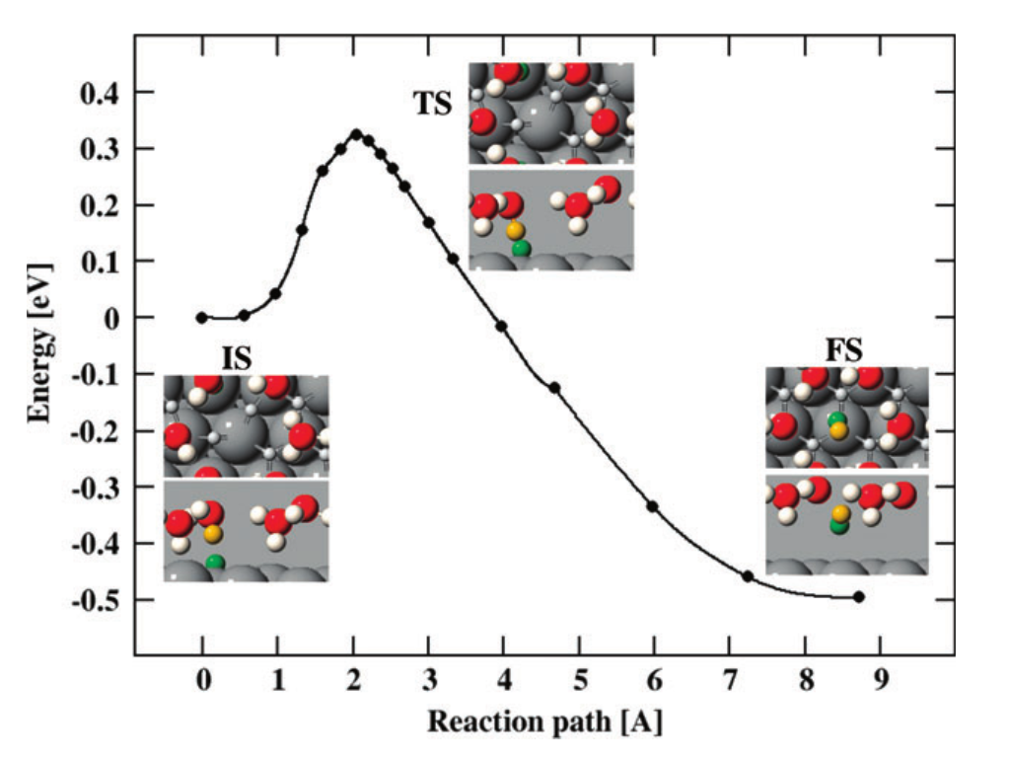
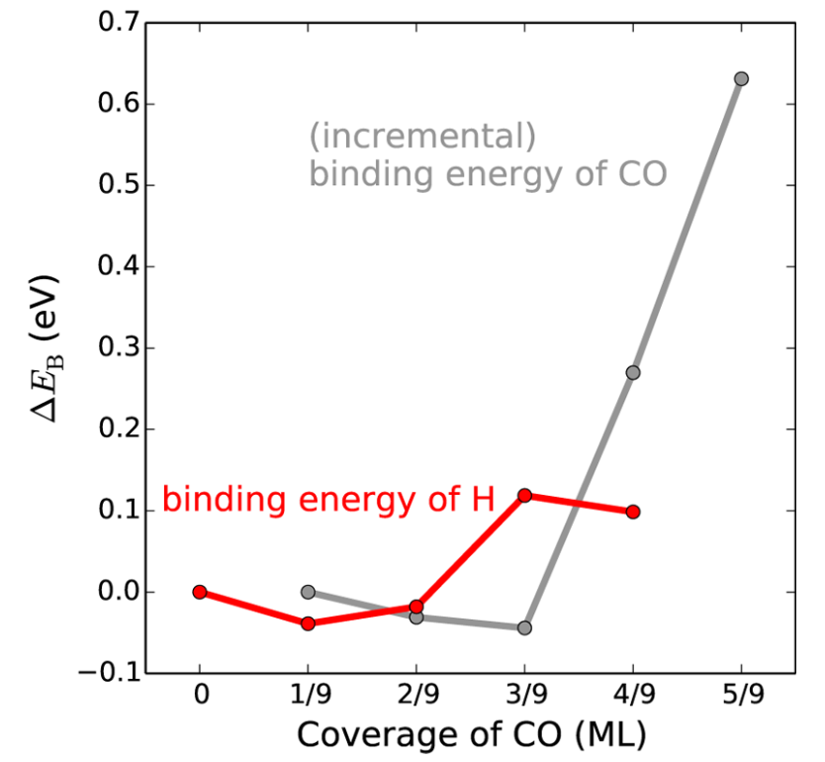
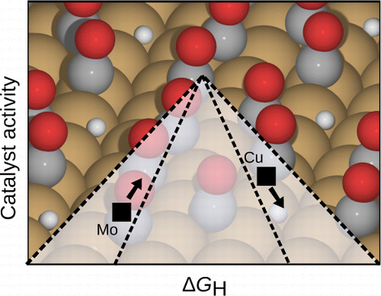
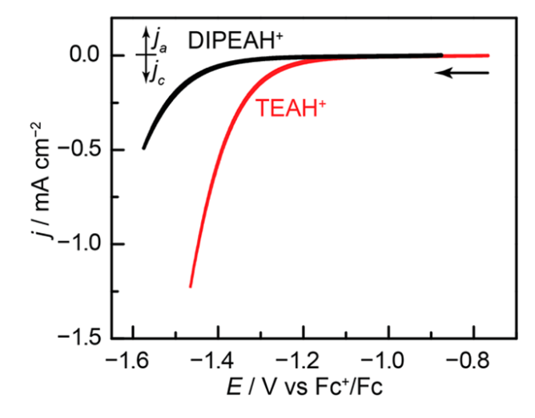
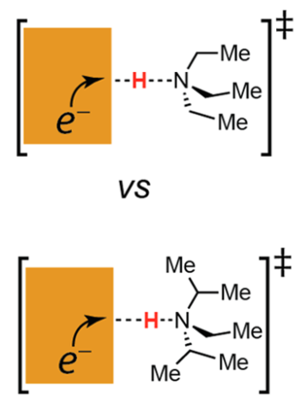
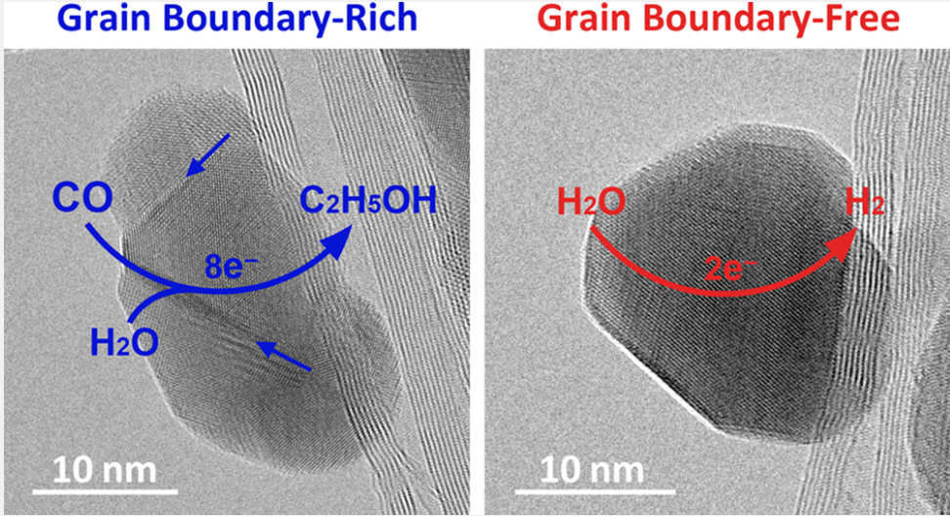
Electrocatalysis
Barriers: Liquid/Solid, potential dependent
High and variable coverage
Skúlason et al. PCCP 9:3241 (2007).
Zhang, et al.. ACS Catal 6:3742 (2014).
Solvent, pH, proton-donor effects
Novel surface effects
Jackson & Surendranath, JACS 138:3228 (2016).
Feng et al. ACS Central Sci 2:169 (2016).
Notes:
Electro chemistry is a branch of chemical physics studying the relationship between chemical change and electricity.
Electrolytic processes (chemical changes as consequence of applied electricity). Galvanic or voltaic processes (chemical reactions producing electricity).
Two half cell reactions: oxidation (loss of electron), and reduction (gain of electron).
Challenging processes to describe from a theoretical point of view (e.g. some of them involve breaking and/or formation of chemical bonds).
Large periodic systems including metals with a large number of electrons.

Slide 3
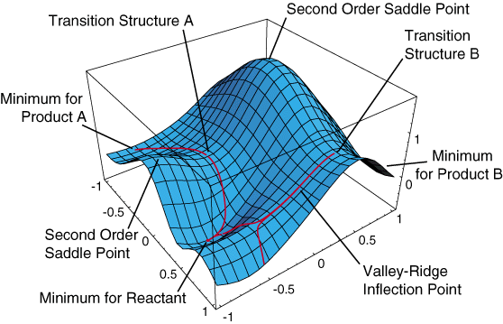
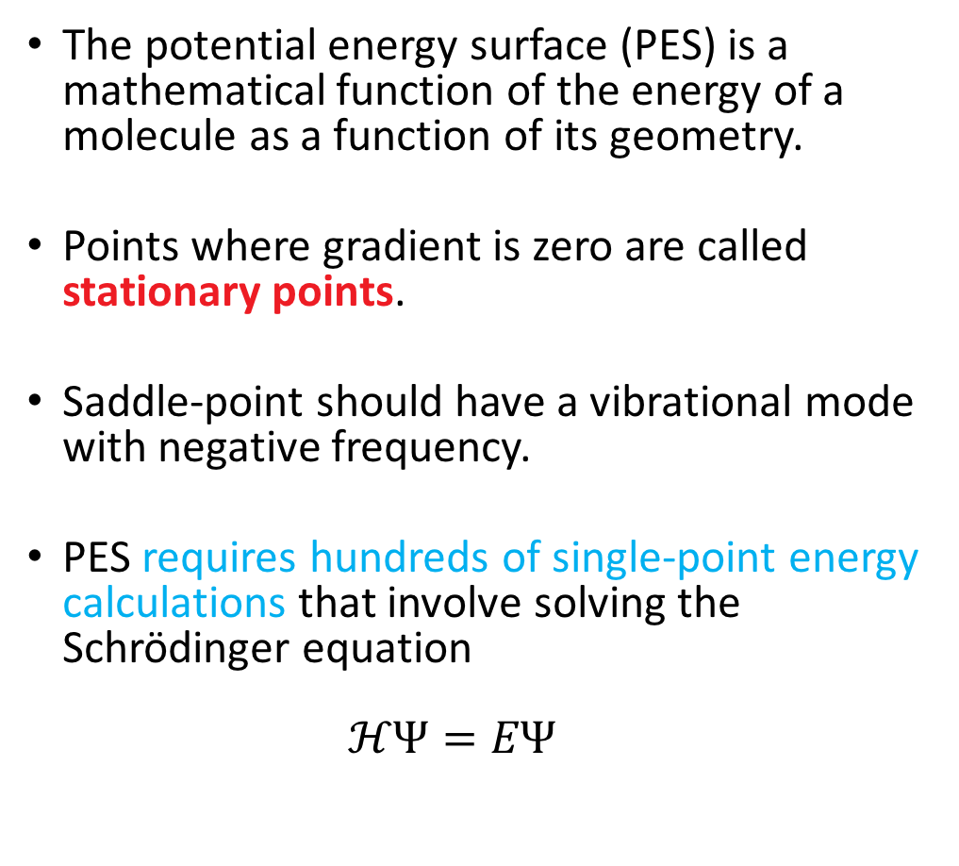
Potential Energy Surfaces and Saddle-Points
The potential energy surface (PES) is a mathematical function of the energy of a molecule as a function of its geometry.
Points where gradient is zero are called stationary points.
Saddle-point should have a vibrational mode with negative frequency.
PES requires hundreds of single-point energy calculations that involve solving the Schrödinger equation $ℋΨ=EΨ$
Schematic representation of a PES.
https://chem.libretexts.org/Core/Physical_and_Theoretical_Chemistry/Quantum_Mechanics/11%3A_Molecules/Potential_Energy_Surface

Slide 4
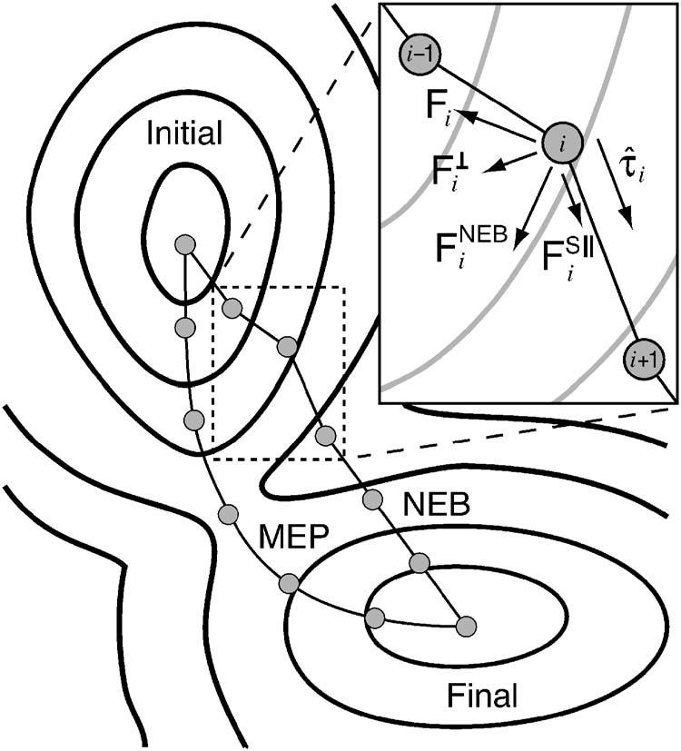
Nudged Elastic Band (NEB)
Given an initial and final images (local minima) the objective is to find the minimum energy path (MEP) in the potential energy surface.
An initial guess for the MEP is an interpolation.
These simulations take days, weeks, or even months. ☹
Jónsson, H., Mills, G., & Jacobsen, K. W. (1998). DOI: 10.1142/9789812839664_0016
Notes:
Given an initial and final images (local minima) the objective is to find the minimum energy path (MEP) in the potential energy surface.
A normal NEB calculation initially guesses the MEP, or intermediate images, by an interpolation.
Spacing between adjacent images in the band are controlled by spring forces.
A force projection decouples the displacements of the images perpendicular to the MEP (estimation of the local tangent for each image on the band). This is known as nudging.

Slide 5
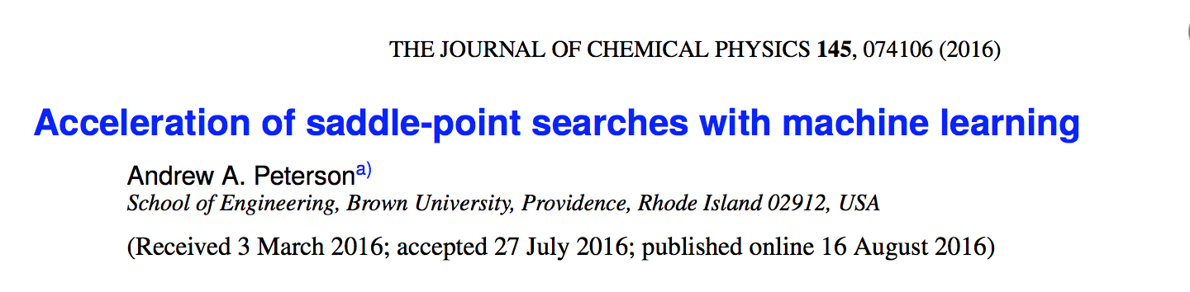

Slide 6
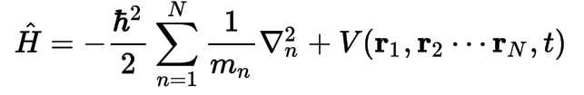

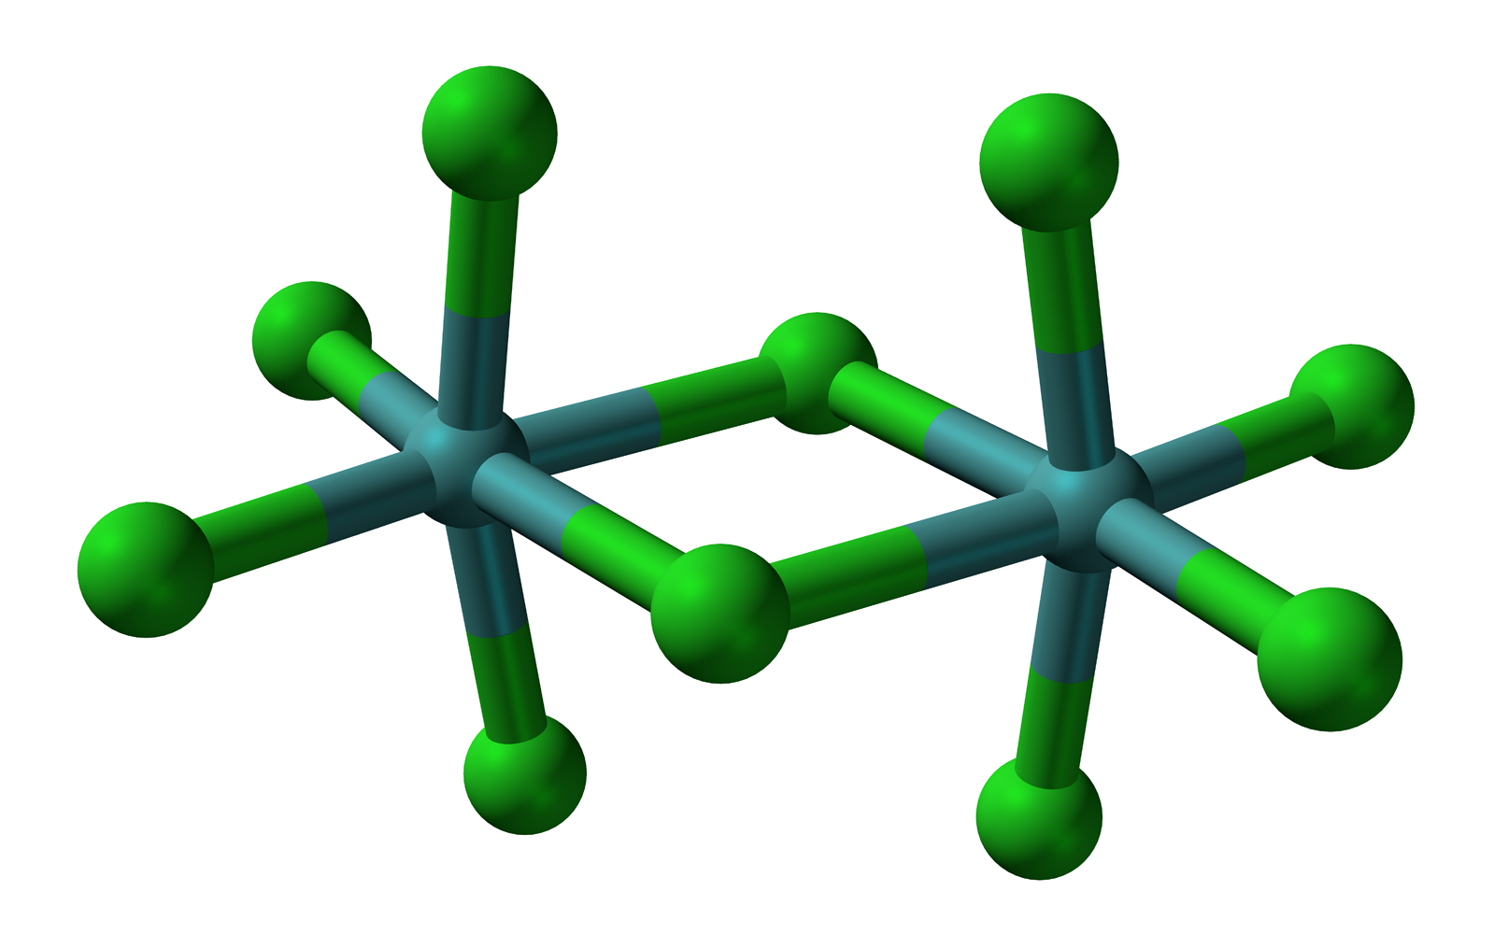
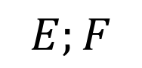
Slow
$$E;F$$

Slide 7

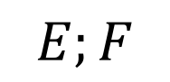
Fast
Machine Learning
$$E;F$$

Slide 8

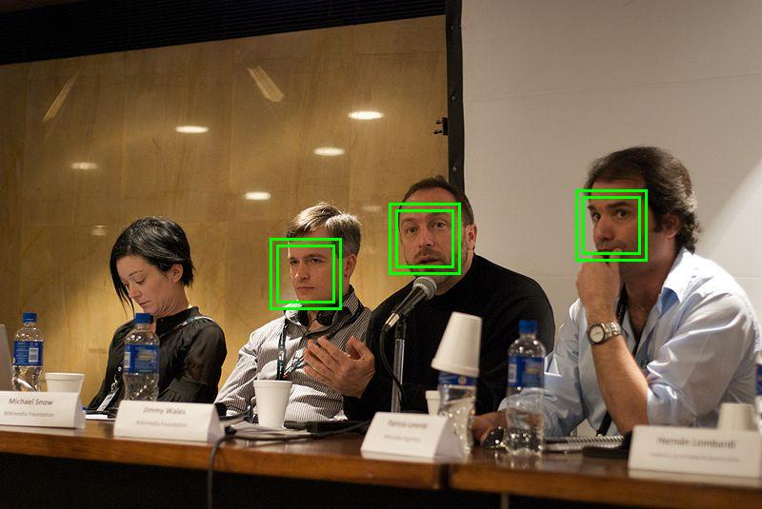
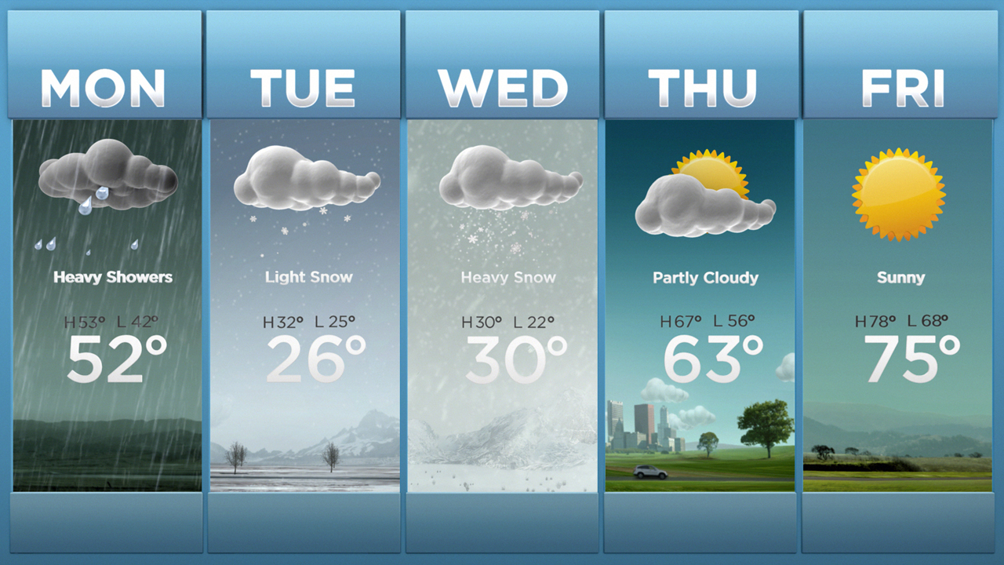
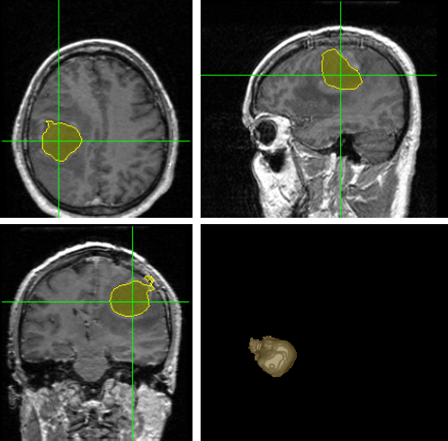


Machine Learning is Everywhere

Slide 9
Machine Learning
According to Tom M. Mitchell:
"A computer program is said to learn from experience E with respect to some class of tasks T and performance measure P if its performance at tasks in T, as measured by P, improves with experience E."

Slide 10
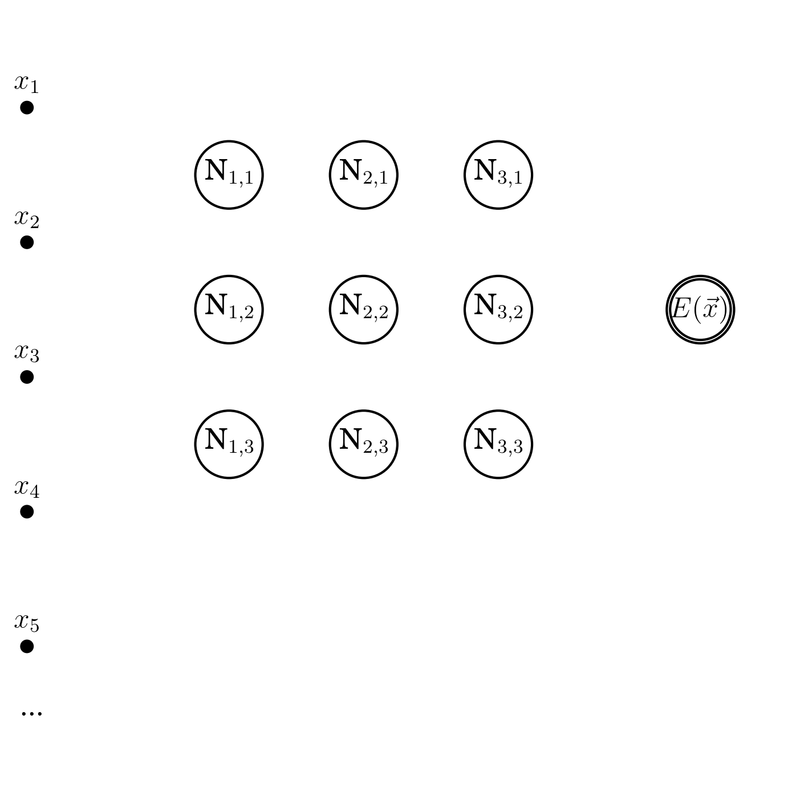
Artificial Neural Networks
Input-layer
Hidden-layers
Output-layer
Inspired on how neurons works in human brain.
Model capable to fit complicated functions (like the potential energy surface).
Regression.
Faster predictions of electronic properties.
Schematic representation of an ANN

Slide 11
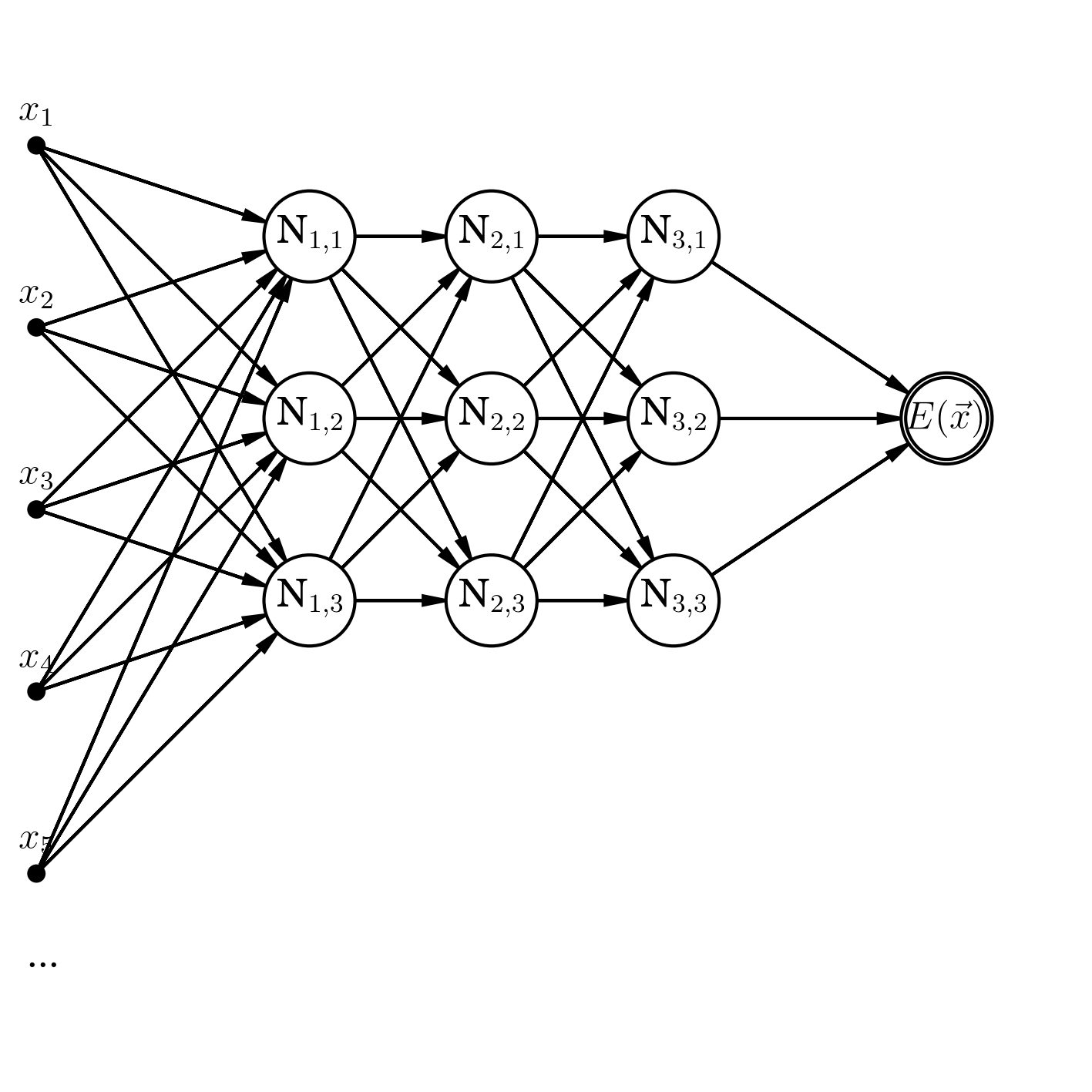
Artificial Neural Networks
Input-layer
Hidden-layers
Output-layer
Inspired on how neurons works in human brain.
Model capable to fit complicated functions (like the potential energy surface).
Regression.
Faster predictions of electronic properties.
Schematic representation of an ANN

Slide 12
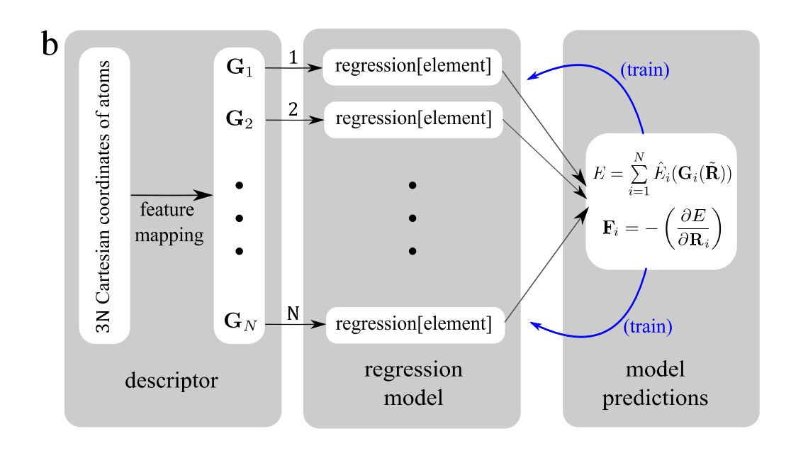
Machine Learning Workflow
Build a training set.
Train the model.
Predict.
Atom-centered mode
Exploit locality.
Size extensive.
Rotational invariant.
Translational invariant.
The Behler-Parrinello Scheme
Behler, J., & Parrinello, M. Physical Review Letters, 98(14), 146401.

Slide 13
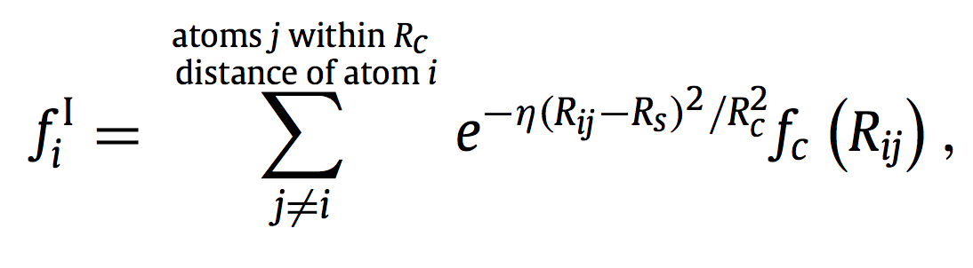
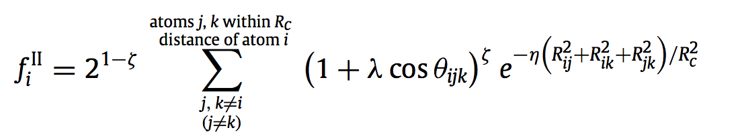
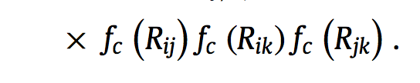
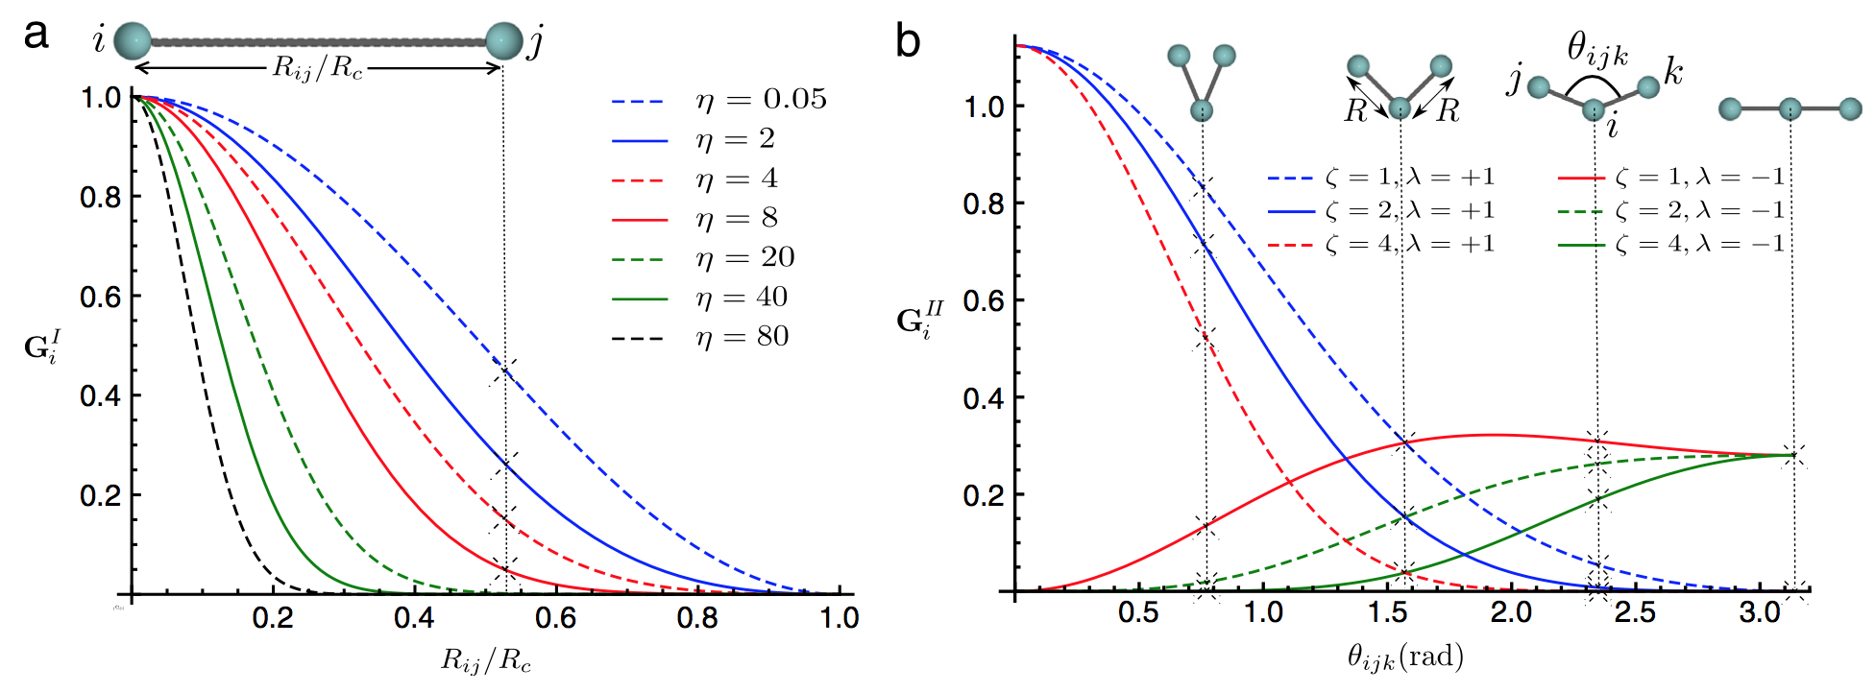
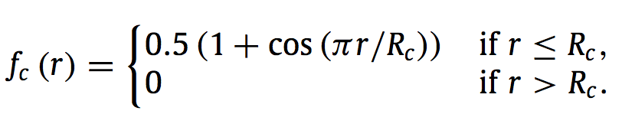
Local Chemical Environment (Descriptor)
a) Radial (two-body interactions)
b) Angular (three-body interactions)
Cutoff function

Slide 14
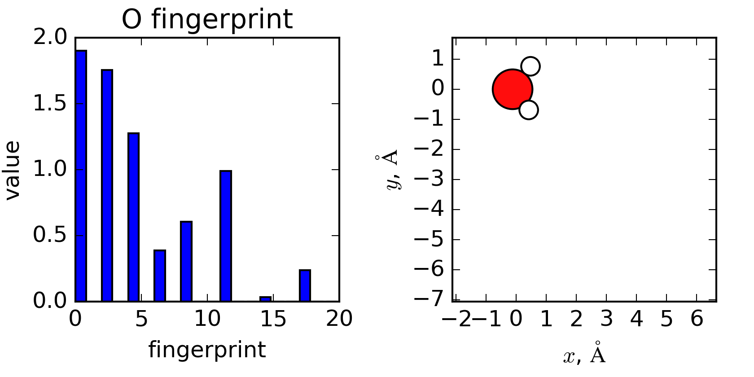
Local Chemical Environment (Descriptor)

Slide 15
Machine Learning NEB Algorithm

Slide 16
The ML-NEB Algorithm
(0)
Initial MEP
Add MEP from (0)
to training set
(1)
(2)
(3)
Energy
&
Force
calls
(DFT)
Train Neural Networks
(ML)
Run NEB with
ML calculator
(4)
MEP
predicted by
ML-NEB
No
Add MEP_{ML} from (5)
to training set
(5)
(7)
(6)
Energy
&
Force
calls
(DFT)
Yes
ML || DFT
Match?*
Final MEP
* Metric used is Mean Absolute Error (MAE)

Slide 17
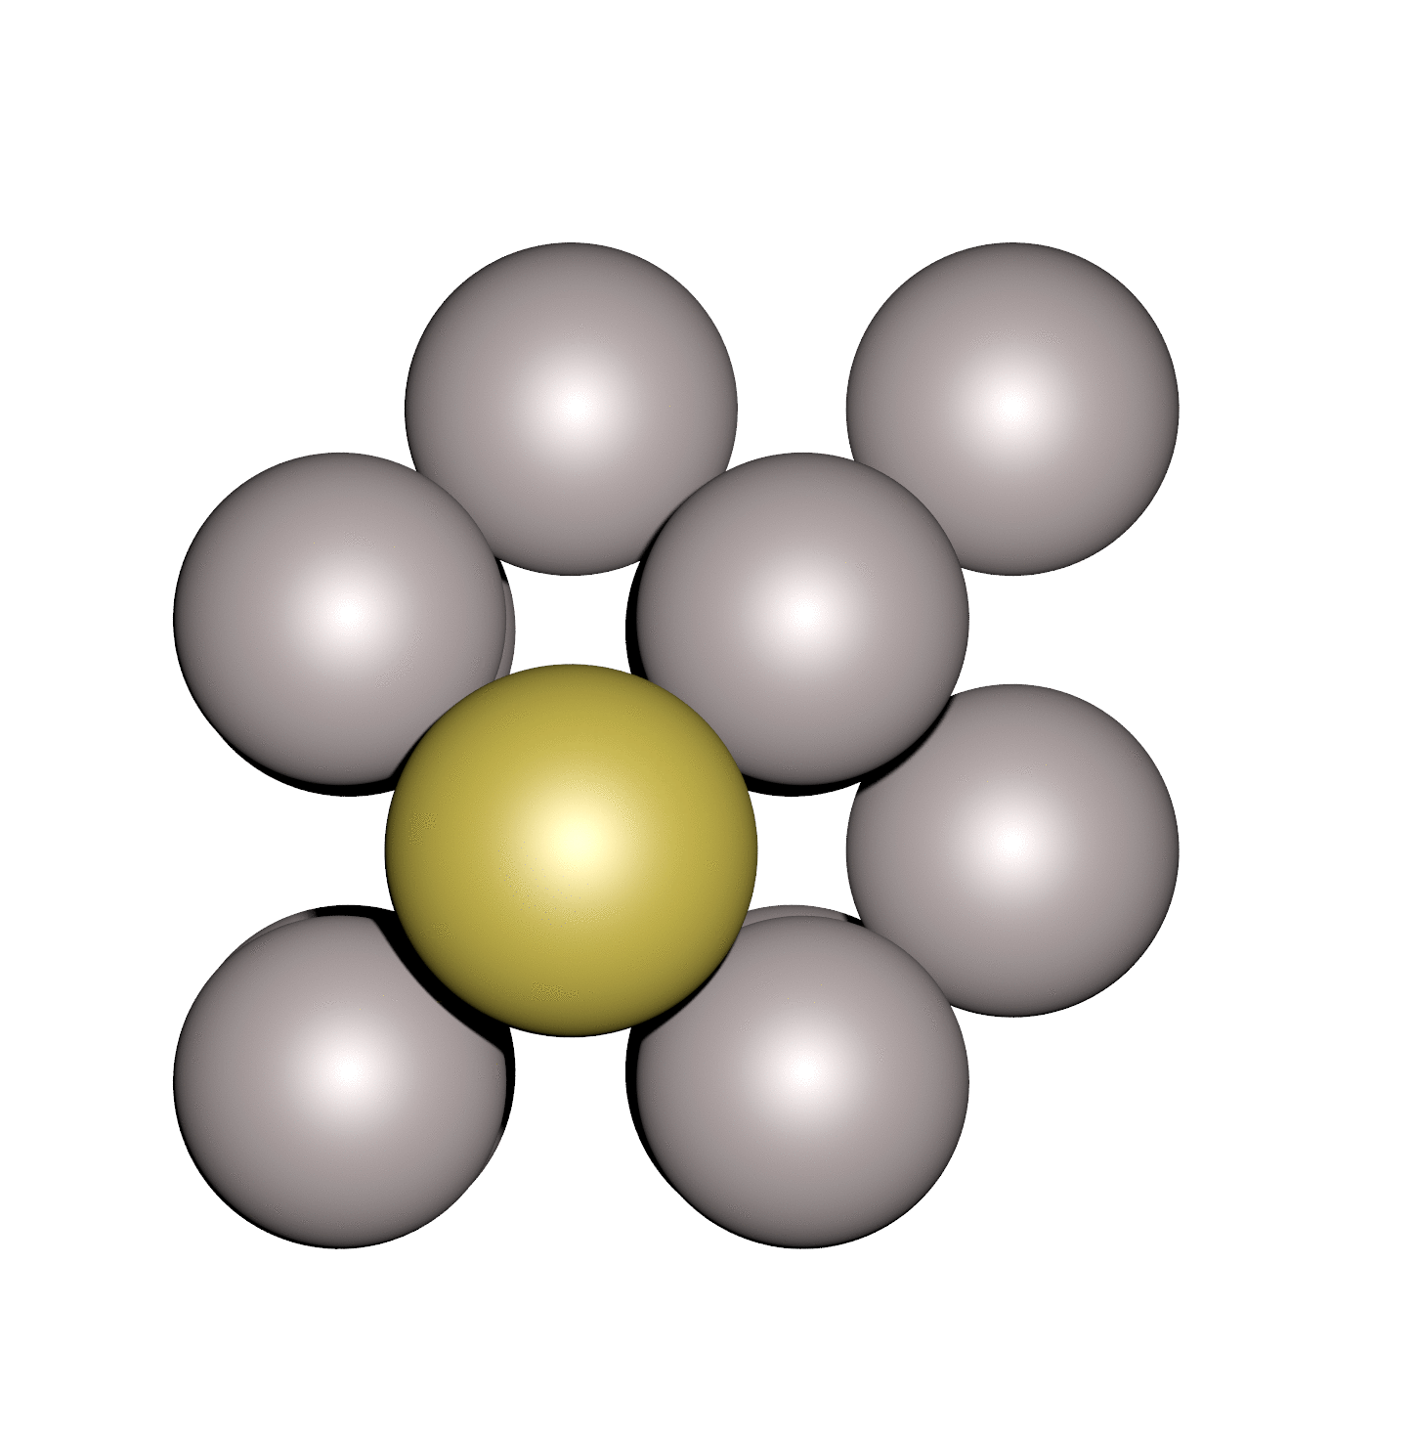
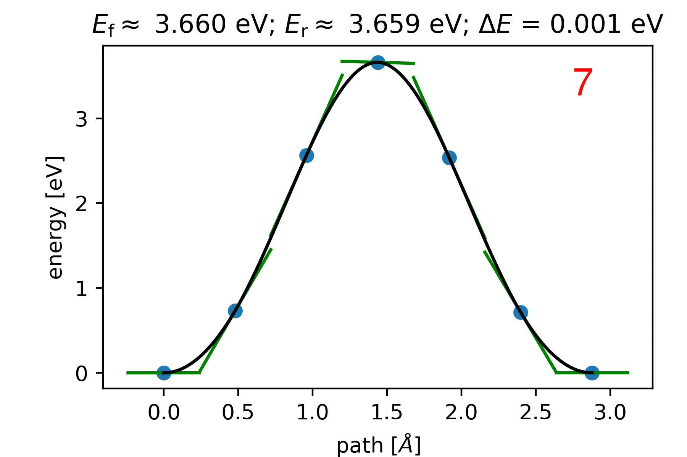
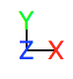
Diffusion of Gold Atom on Al(100) Surface
DFT
Force calls
NEB (f_{max} = 0.05 eV/Å, 5 intermediates).
GPAW, with a LDA exchange correlation functional.
Plane-wave mode.
112 DFT Force calls.
Notes:
NEB (f_{max} = 0.05 eV/Å, 5 intermediates).
GPAW, with a LDA exchange correlation functional.
Plane-wave mode (energy cutoff = 350 eV).
K-points (2, 2, 1).

Slide 18
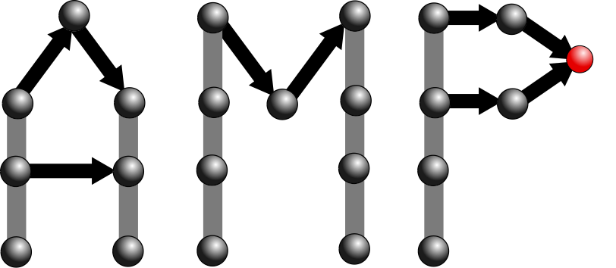
Machine Learning Acceleration Tools
https://bitbucket.com/andrewpeterson/amp
The Atomistic Machine-Learning Package (AMP).
The Atomic Simulation Environment (ASE).
Objective: decrease number of DFT energy and force calls.
Notes:
Add axis to the figure.

Slide 19
Progress of Mean Absolute Error
afp(20)
afp(20)
afp(40)
afp(40)
Mean absolute error (MAE) as a function of the # of iterations in ML-NEB
* afp: atomic fingerprint; MAE_{max} = 0.02 eV/Å.
Notes:
Change this figure increasing size of font.

Slide 20
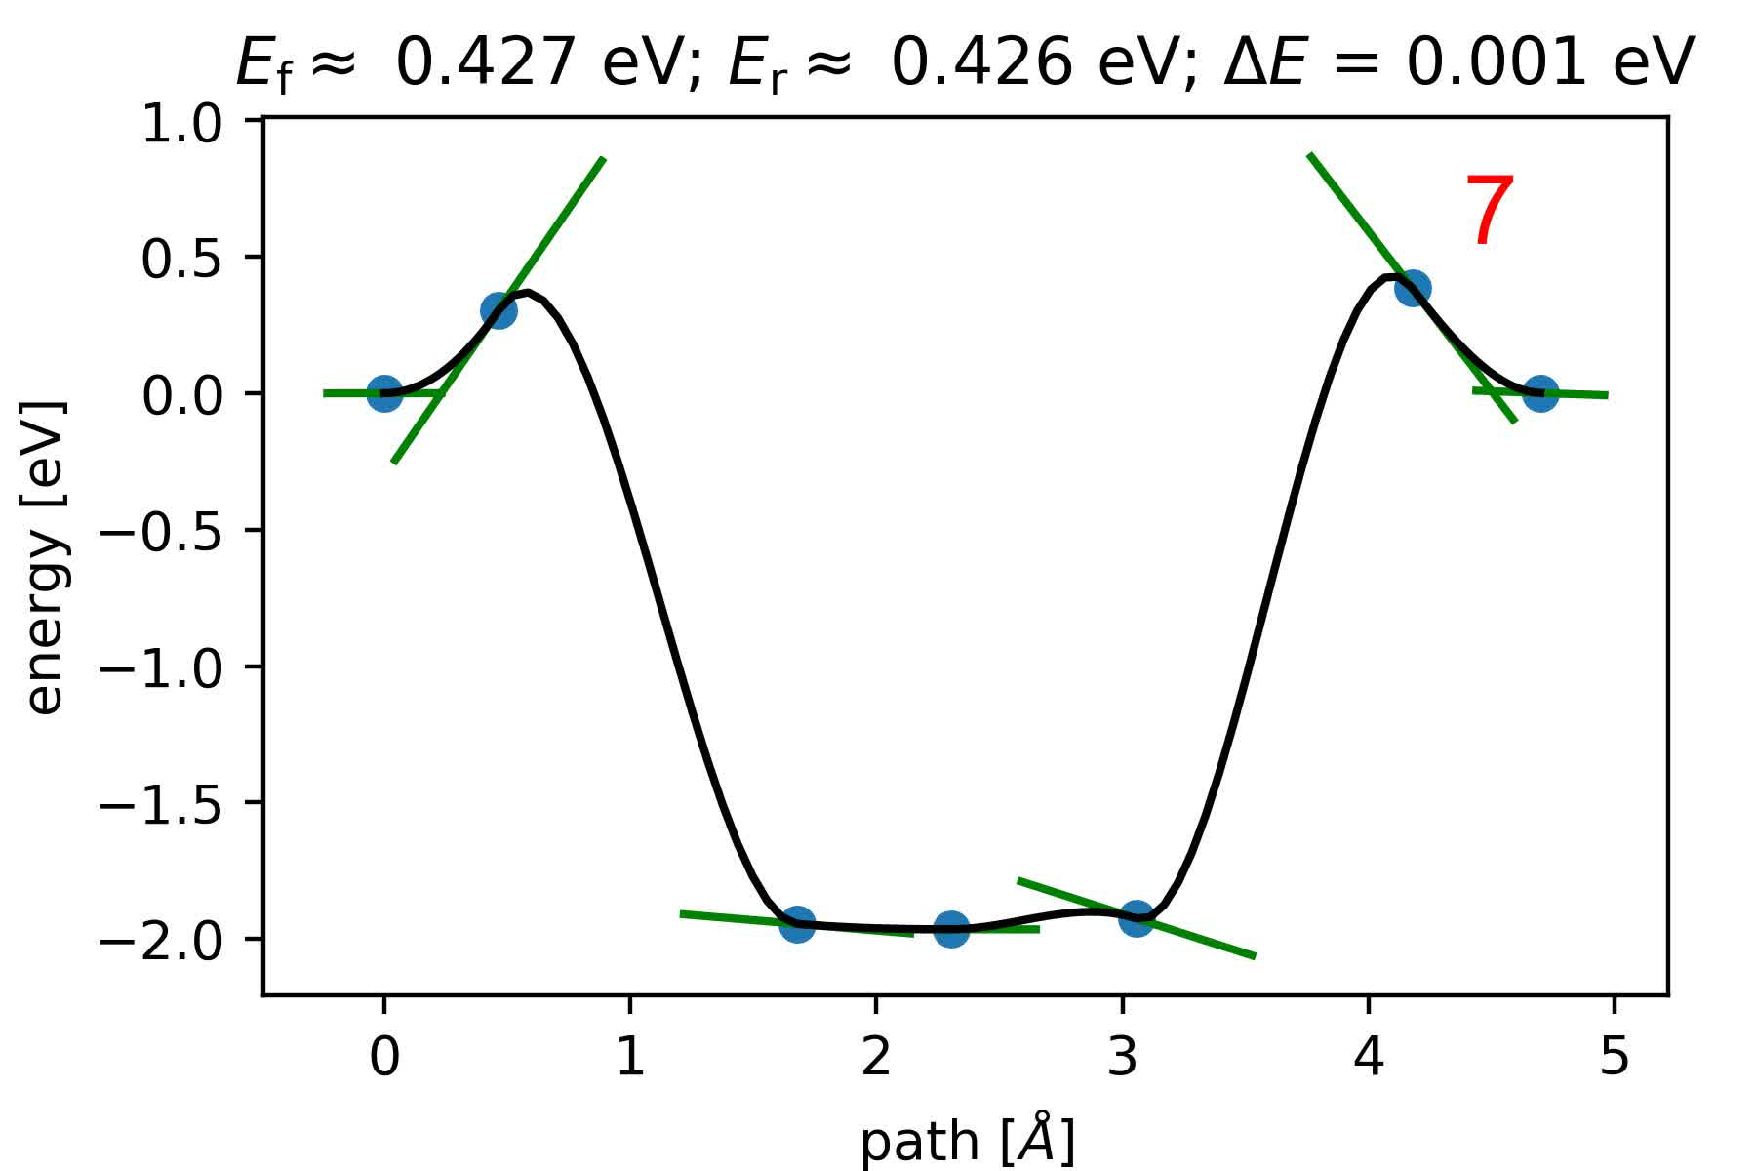
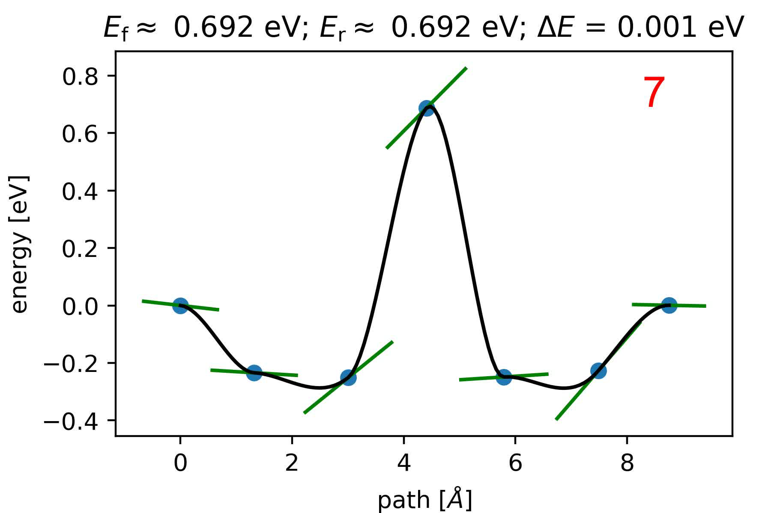
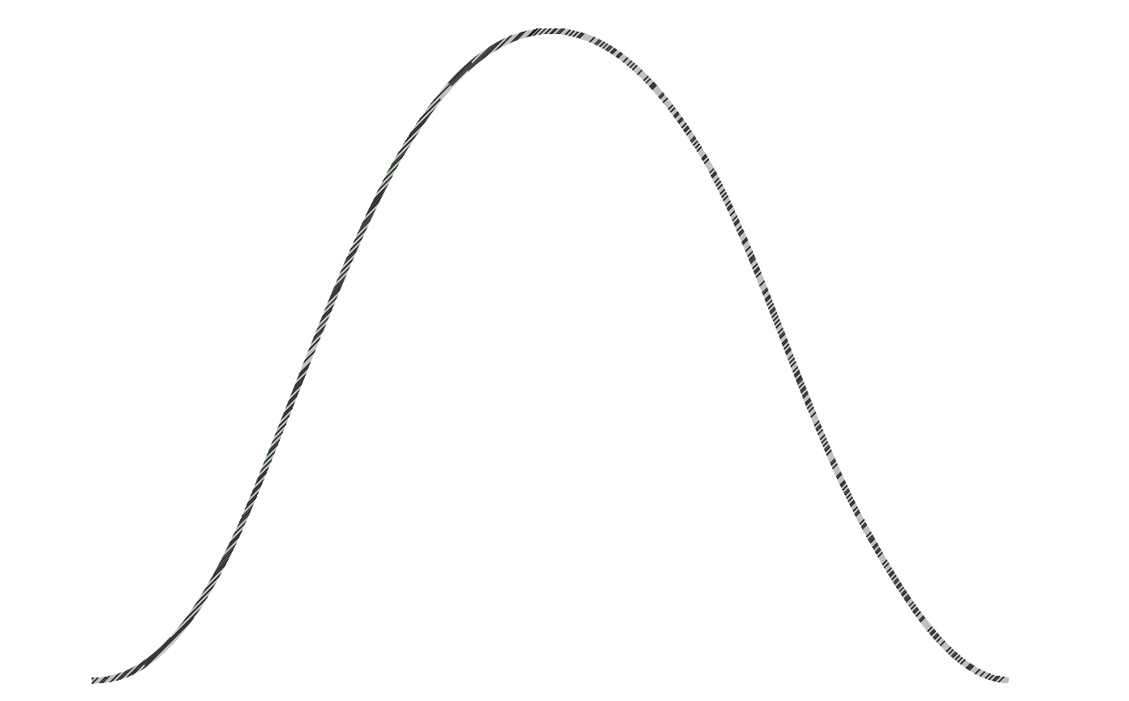
Evolution of MEP Guessed by ML-NEB
(a)
(b)
DFT
DFT
afp(40); NN(10, 10)
afp(40); NN(20, 20)
Pure DFT
Figure | DFT force calls | Energy MAE (eV) | Forces MAE (eV/Å)
(a) | 17 | 0.005 | 0.011
(b) | 22 | 0.002 | 0.008

Slide 21
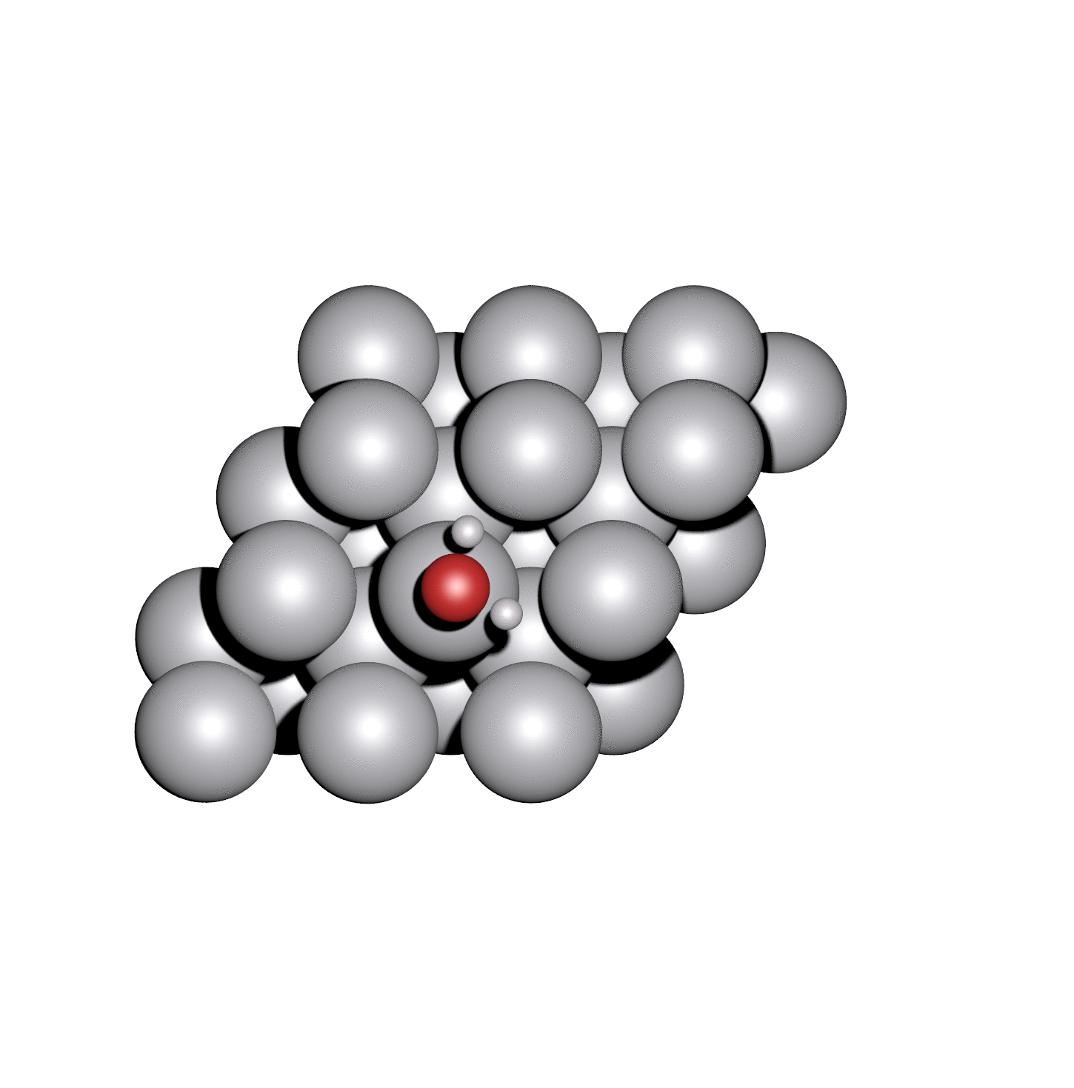
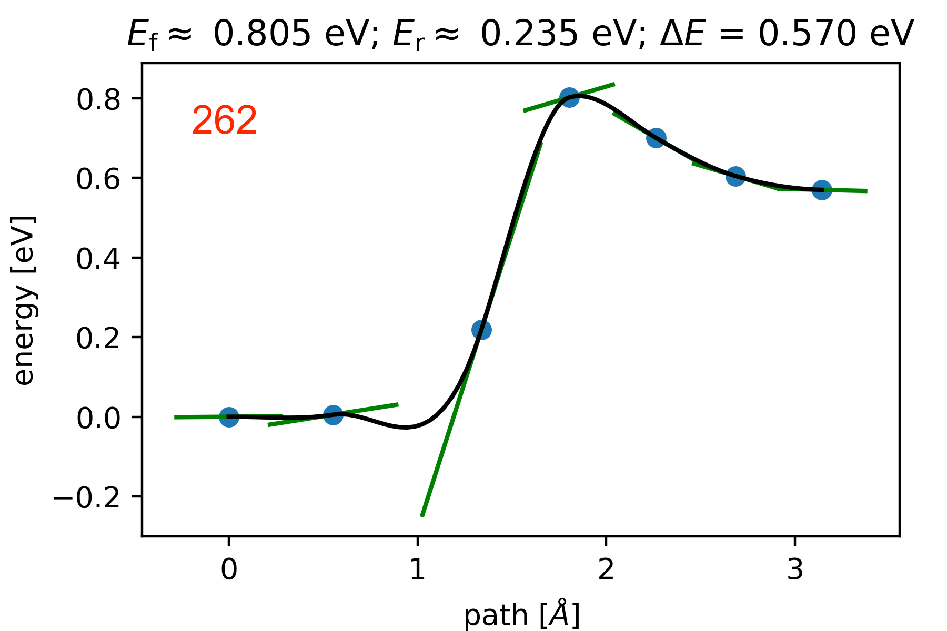
Water Dissociation on Pt(111)
DFT
Force calls
NEB (f_{max} = 0.05 eV/Å, 5 intermediates).
GPAW, with PW91 exchange correlation functional.
Plane-wave mode.
262 force calls at DFT level to optimize the band.
Notes:
GPAW, with PW91 exchange correlation functional.
Plane-wave mode (energy cutoff = 600 eV).
K-points (3, 3, 1).
NEB (f_{max} = 0.05 eV/Å, 5 intermediates).
262 force calls at DFT level to optimize the band.

Slide 22
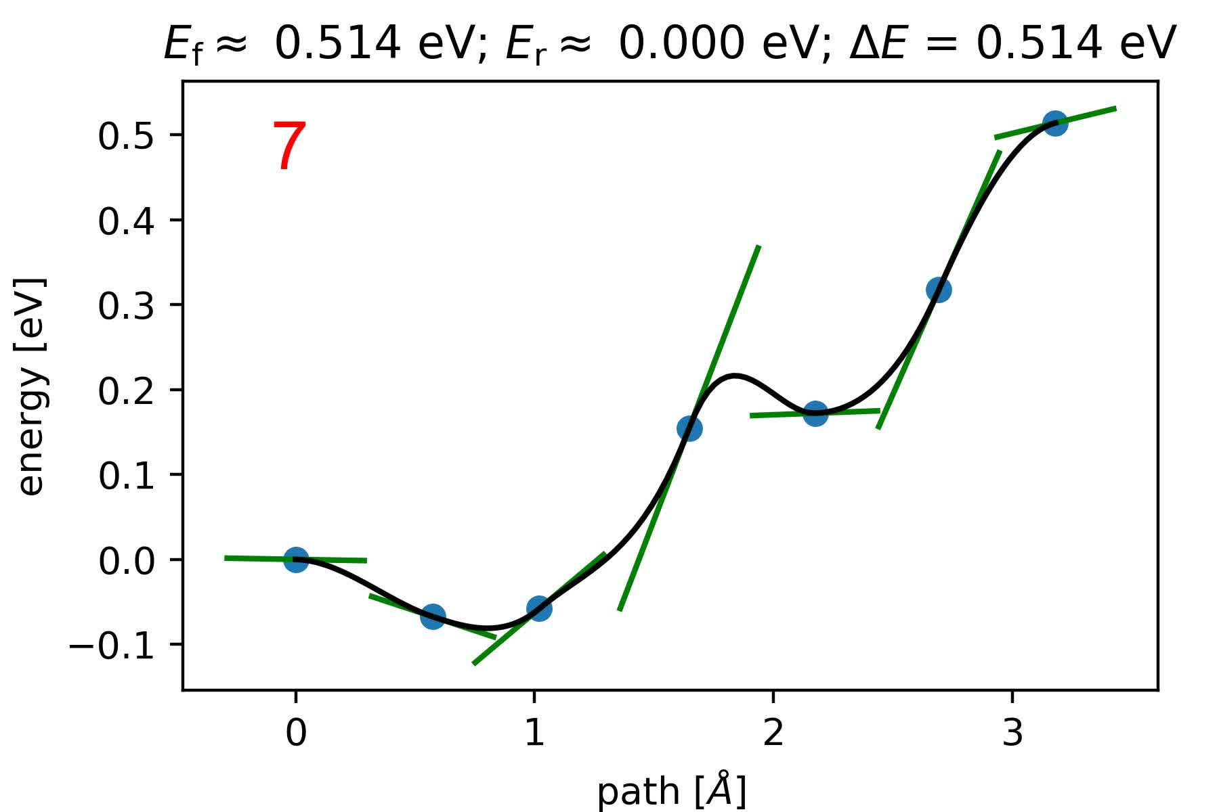
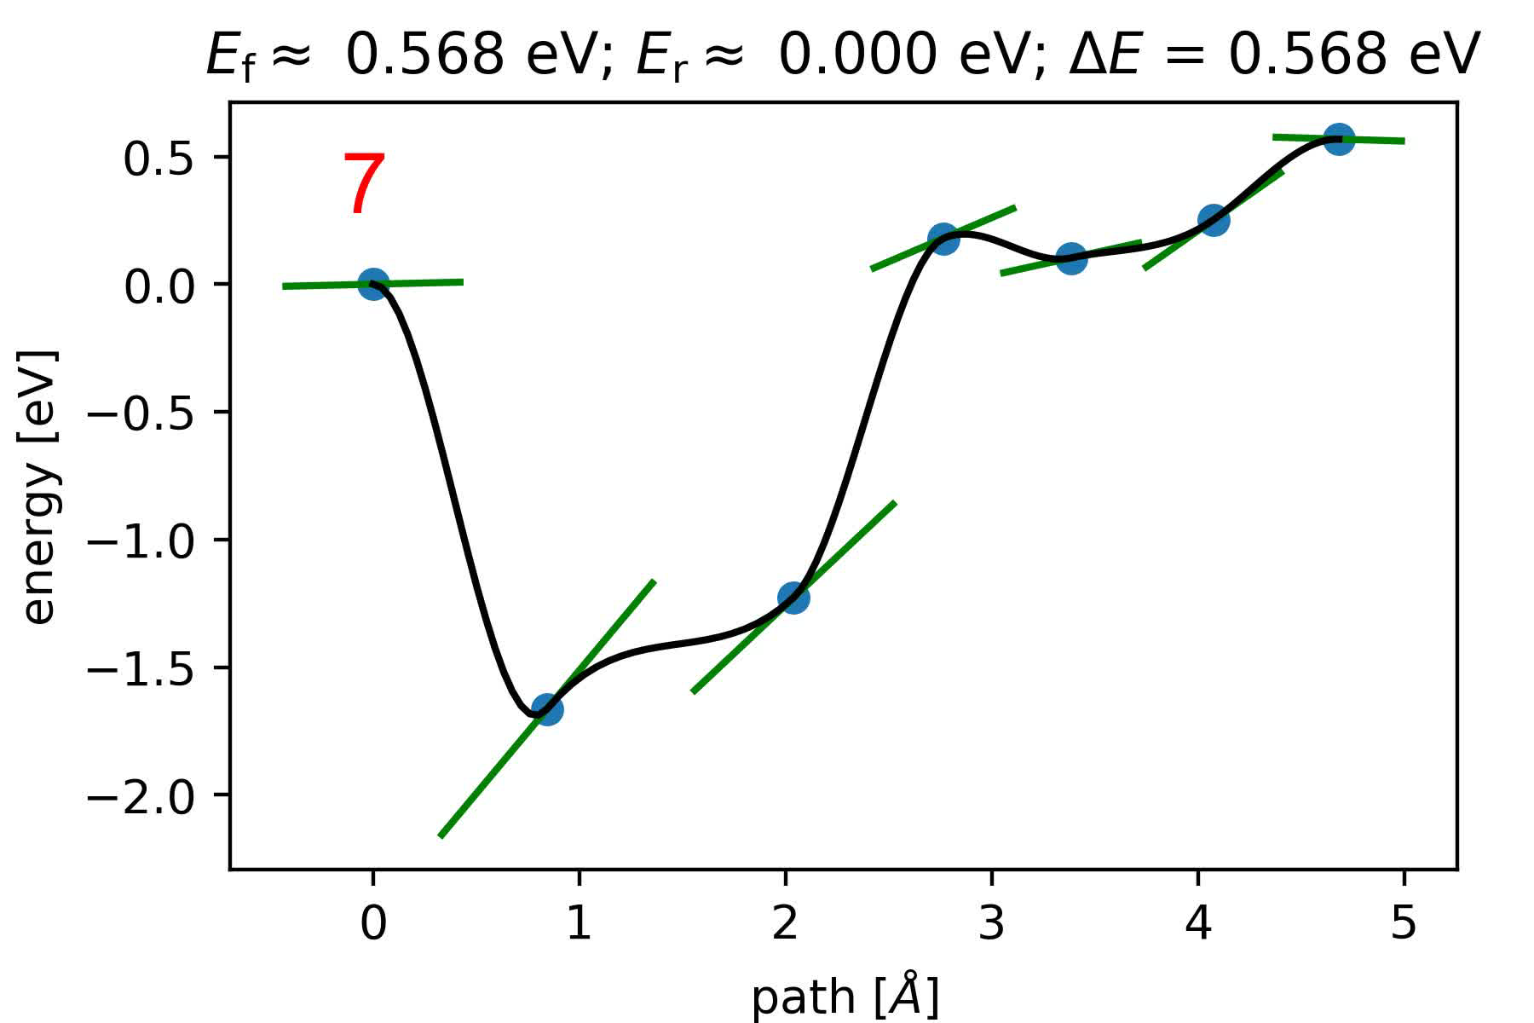

Evolution of MEP Guessed by ML-NEB
(c)
(d)
DFT
DFT
afp(72); NN(10, 10)
afp(72); NN(20, 20)
Pure DFT
Figure | DFT force calls | Energy MAE (eV) | Forces MAE (eV/Å)
(c) | 37 | 0.035 | 0.042
(d) | 32 | 0.020 | 0.061
Notes:
Left: /Volumes/melkhati/data/melkhati/accelerate/_2.NN10_0.05_0.05_c6.5.moreGs_maxrunsteps100.fixedcode_NOH

Slide 23
Conclusions
Nudged elastic band can be successfully coupled with machine learning models, and can be applied to more complex systems.
The number of DFT calls decreases dramatically when NEB is accelerated with machine learning.
Increasing training set size decreases the error on predictions.
Our ML-NEB algorithm allows the construction of training data in a logical and consistent way.

Slide 24
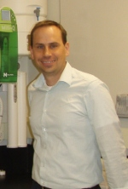

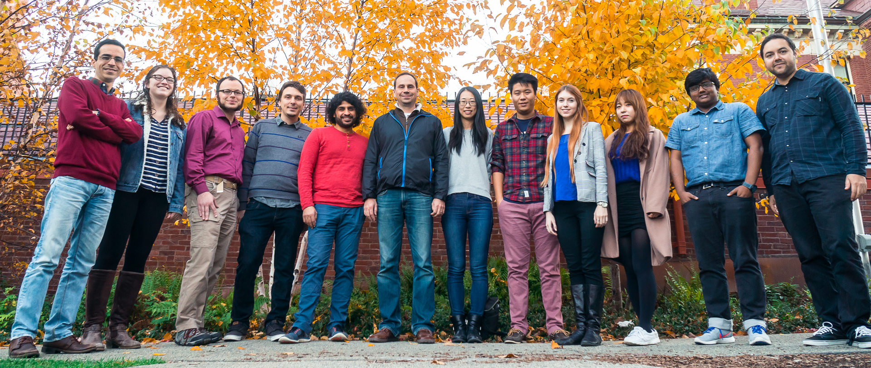

Acknowledgments
Prof. Andrew Peterson
Alireza Khorshidi
National Science Foundation (NSF) grant nº 1553365.
School of Engineering, Brown University.
This research was conducted using computational resources and services at the Center for Computation and Visualization, Brown University.

Slide 25

Thanks
Slides available online at https://muammar.me/files/chemistry

